Slide 1
Lecture 18 Sorting
CSE225: Data Structures and Algorithms

Slide 2
Sorting and Searching
Fundamental problems in computer science and programming
Sorting done to make searching easier
Multiple different algorithms to solve the same problem
How do we know which algorithm is "better"?
Let review searching first (We have already covered it.)

Slide 3

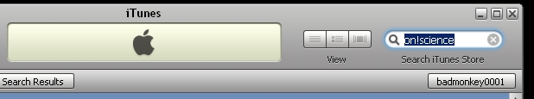
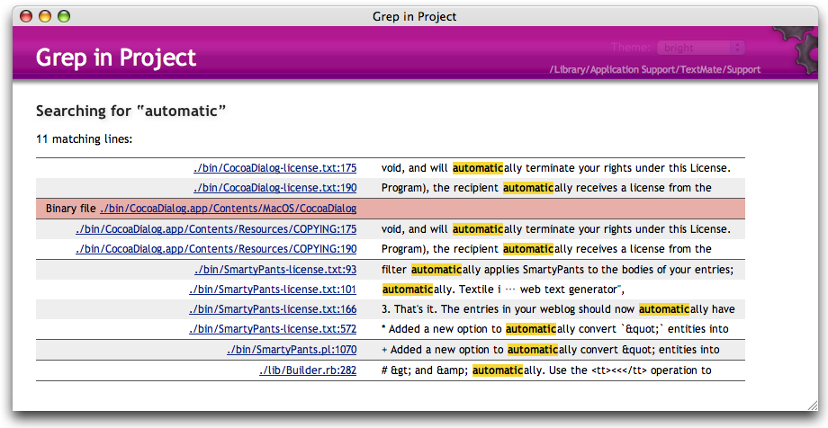

Searching

Slide 4

Searching
Given a list of data find the location of a particular value or report that value is not present
linear search
intuitive approach
start at first item
is it the one I am looking for?
if not go to next item
repeat until found or all items checked
If items not sorted or unsortable this approach is necessary

Slide 5
Attendance Question 1
What is the average case Big O of linear search in an array with N items, if an item is present?
O(N)
O(N²)
O(1)
O(logN)
O(NlogN)

Slide 6
Searching in a Sorted List
If items are sorted then we can divide and conquer
dividing your work in half with each step
generally a good thing
The Binary Search on List in Ascending order
Start at middle of list
is that the item?
If not is it less than or greater than the item?
less than, move to second half of list
greater than, move to first half of list
repeat until found or sub list size = 0

Slide 7
Attendance Question 2
What is the worst case Big O of binary search in an array with N items, if an item is present?
O(N)
O(N²)
O(1)
O(logN)
O(NlogN)

Slide 8
Sorting
A fundamental application for computers
Done to make finding data (searching) faster
Many different algorithms for sorting
One of the difficulties with sorting is working with a fixed size storage container (array)
if resize, that is expensive (slow)
The "simple" sorts run in quadratic time O(N²)
bubble sort
selection sort
insertion sort

Slide 9

Sorting Fun Why Not Bubble Sort?

Slide 10
Bubble Sort
5 | 1 | 3 | 4 | 6 | 2
Comparison
Data Movement
Sorted

Slide 11
Bubble Sort
5 | 1 | 3 | 4 | 6 | 2
Comparison
Data Movement
Sorted

Slide 12
Bubble Sort
5 | 1 | 3 | 4 | 2 | 6
Comparison
Data Movement
Sorted

Slide 13
Bubble Sort
5 | 1 | 3 | 4 | 2 | 6
Comparison
Data Movement
Sorted

Slide 14
Bubble Sort
5 | 1 | 3 | 2 | 4 | 6
Comparison
Data Movement
Sorted

Slide 15
Bubble Sort
5 | 1 | 3 | 2 | 4 | 6
Comparison
Data Movement
Sorted

Slide 16
Bubble Sort
5 | 1 | 2 | 3 | 4 | 6
Comparison
Data Movement
Sorted

Slide 17
Bubble Sort
5 | 1 | 2 | 3 | 4 | 6
Comparison
Data Movement
Sorted

Slide 18
Bubble Sort
5 | 1 | 2 | 3 | 4 | 6
Comparison
Data Movement
Sorted

Slide 19
Bubble Sort
1 | 5 | 2 | 3 | 4 | 6
Comparison
Data Movement
Sorted

Slide 20
Bubble Sort
1 | 5 | 2 | 3 | 4 | 6
Comparison
Data Movement
Sorted

Slide 21
Bubble Sort
1 | 5 | 2 | 3 | 4 | 6
Comparison
Data Movement
Sorted

Slide 22
Bubble Sort
1 | 5 | 2 | 3 | 4 | 6
Comparison
Data Movement
Sorted

Slide 23
Bubble Sort
1 | 5 | 2 | 3 | 4 | 6
Comparison
Data Movement
Sorted

Slide 24
Bubble Sort
1 | 5 | 2 | 3 | 4 | 6
Comparison
Data Movement
Sorted

Slide 25
Bubble Sort
1 | 2 | 5 | 3 | 4 | 6
Comparison
Data Movement
Sorted

Slide 26
Bubble Sort
1 | 2 | 5 | 3 | 4 | 6
Comparison
Data Movement
Sorted

Slide 27
Bubble Sort
1 | 2 | 5 | 3 | 4 | 6
Comparison
Data Movement
Sorted

Slide 28
Bubble Sort
1 | 2 | 5 | 3 | 4 | 6
Comparison
Data Movement
Sorted

Slide 29
Bubble Sort
1 | 2 | 5 | 3 | 4 | 6
Comparison
Data Movement
Sorted

Slide 30
Bubble Sort
1 | 2 | 3 | 5 | 4 | 6
Comparison
Data Movement
Sorted

Slide 31
Bubble Sort
1 | 2 | 3 | 5 | 4 | 6
Comparison
Data Movement
Sorted

Slide 32
Bubble Sort
1 | 2 | 3 | 5 | 4 | 6
Comparison
Data Movement
Sorted

Slide 33
Bubble Sort
1 | 2 | 3 | 5 | 4 | 6
Comparison
Data Movement
Sorted

Slide 34
Bubble Sort
1 | 2 | 3 | 4 | 5 | 6
Comparison
Data Movement
Sorted

Slide 35
Bubble Sort
1 | 2 | 3 | 4 | 5 | 6
Comparison
Data Movement
Sorted

Slide 36
Bubble Sort
1 | 2 | 3 | 4 | 5 | 6
Comparison
Data Movement
Sorted

Slide 37
Bubble Sort
1 | 2 | 3 | 4 | 5 | 6
Comparison
Data Movement
Sorted

Slide 38
Bubble Sort
template<class ItemType>
void Swap(ItemType& item1, ItemType& item2)
{
ItemType tempItem;
tempItem = item1;
item1 = item2;
item2 = tempItem;
}

Slide 39
Bubble Sort
template<class ItemType>
void BubbleUp(ItemType values[] , int startIndex, int endIndex)
{
for (int index = endIndex; index > startIndex; index--)
if (values[index-1] > values[index])
Swap(values[index-1], values[index]);
}
template<class ItemType>
void BubbleSort(ItemType values[], int numValues)
{
int current = 0;
while (current < numValues - 1)
{
BubbleUp(values, current, numValues-1);
current++;
}
}

Slide 40
Bubble Sort
template<class ItemType>
void BubbleUp(ItemType values[] , int startIndex, int endIndex)
{
for (int index = endIndex; index > startIndex; index--)
if (values[index-1] > values[index])
Swap(values[index-1], values[index]);
}
template<class ItemType>
void BubbleSort(ItemType values[], int numValues)
{
int current = 0;
while (current < numValues - 1)
{
BubbleUp(values, current, numValues-1);
current++;
}
}
O(N)
O(N)
O(N²)

Slide 41
Bubble Sort (little improved)
template<class ItemType>
void BubbleUp2(ItemType values[], int startIndex, int endIndex, bool& sorted)
{
sorted = true;
for (int index = endIndex; index > startIndex; index--)
if (values[index] < values[index-1])
{
Swap(values[index], values[index-1]);
sorted = false;
}
}
template<class ItemType>
void ShortBubble(ItemType values[], int numValues)
{
int current = 0;
bool sorted = false;
while (current < numValues - 1 && !sorted)
{
BubbleUp2(values, current, numValues-1, sorted);
current++;
}
}

Slide 42
Selection Sort
5 | 1 | 3 | 4 | 6 | 2
Comparison
Data Movement
Sorted

Slide 43
Selection Sort
5 | 1 | 3 | 4 | 6 | 2
•
Current
Comparison
Data Movement
Sorted

Slide 44
Selection Sort
5 | 1 | 3 | 4 | 6 | 2
•
Current
Comparison
Data Movement
Sorted

Slide 45
Selection Sort
5 | 1 | 3 | 4 | 6 | 2
•
Current
Comparison
Data Movement
Sorted

Slide 46
Selection Sort
5 | 1 | 3 | 4 | 6 | 2
•
Current
Comparison
Data Movement
Sorted

Slide 47
Selection Sort
5 | 1 | 3 | 4 | 6 | 2
•
Current
Comparison
Data Movement
Sorted

Slide 48
Selection Sort
5 | 1 | 3 | 4 | 6 | 2
•
Current
Comparison
Data Movement
Sorted

Slide 49
Selection Sort
5 | 1 | 3 | 4 | 6 | 2
•
Current
Comparison
Data Movement
Sorted

Slide 50
Selection Sort
5 | 1 | 3 | 4 | 6 | 2
•
Current
•
Smallest
Comparison
Data Movement
Sorted

Slide 51
Selection Sort
1 | 5 | 3 | 4 | 6 | 2
•
Current
•
Smallest
Comparison
Data Movement
Sorted

Slide 52
Selection Sort
1 | 5 | 3 | 4 | 6 | 2
Comparison
Data Movement
Sorted

Slide 53
Selection Sort
1 | 5 | 3 | 4 | 6 | 2
•
Current
Comparison
Data Movement
Sorted

Slide 54
Selection Sort
1 | 5 | 3 | 4 | 6 | 2
•
Current
Comparison
Data Movement
Sorted

Slide 55
Selection Sort
1 | 5 | 3 | 4 | 6 | 2
•
Current
Comparison
Data Movement
Sorted

Slide 56
Selection Sort
1 | 5 | 3 | 4 | 6 | 2
•
Current
Comparison
Data Movement
Sorted

Slide 57
Selection Sort
1 | 5 | 3 | 4 | 6 | 2
•
Current
Comparison
Data Movement
Sorted

Slide 58
Selection Sort
1 | 5 | 3 | 4 | 6 | 2
•
Current
Comparison
Data Movement
Sorted

Slide 59
Selection Sort
1 | 5 | 3 | 4 | 6 | 2
•
Current
•
Smallest
Comparison
Data Movement
Sorted

Slide 60
Selection Sort
1 | 2 | 3 | 4 | 6 | 5
•
Current
•
Smallest
Comparison
Data Movement
Sorted

Slide 61
Selection Sort
1 | 2 | 3 | 4 | 6 | 5
Comparison
Data Movement
Sorted

Slide 62
Selection Sort
1 | 2 | 3 | 4 | 6 | 5
•
Current
Comparison
Data Movement
Sorted

Slide 63
Selection Sort
1 | 2 | 3 | 4 | 6 | 5
•
Current
Comparison
Data Movement
Sorted

Slide 64
Selection Sort
1 | 2 | 3 | 4 | 6 | 5
•
Current
Comparison
Data Movement
Sorted

Slide 65
Selection Sort
1 | 2 | 3 | 4 | 6 | 5
•
Current
Comparison
Data Movement
Sorted

Slide 66
Selection Sort
1 | 2 | 3 | 4 | 6 | 5
•
Current
Comparison
Data Movement
Sorted

Slide 67
Selection Sort
1 | 2 | 3 | 4 | 6 | 5
•
Current
•
Smallest
Comparison
Data Movement
Sorted

Slide 68
Selection Sort
1 | 2 | 3 | 4 | 6 | 5
•
Current
•
Smallest
Comparison
Data Movement
Sorted

Slide 69
Selection Sort
1 | 2 | 3 | 4 | 6 | 5
Comparison
Data Movement
Sorted

Slide 70
Selection Sort
1 | 2 | 3 | 4 | 6 | 5
•
Current
Comparison
Data Movement
Sorted

Slide 71
Selection Sort
1 | 2 | 3 | 4 | 6 | 5
•
Current
Comparison
Data Movement
Sorted

Slide 72
Selection Sort
1 | 2 | 3 | 4 | 6 | 5
•
Current
Comparison
Data Movement
Sorted

Slide 73
Selection Sort
1 | 2 | 3 | 4 | 6 | 5
•
Current
Comparison
Data Movement
Sorted

Slide 74
Selection Sort
1 | 2 | 3 | 4 | 6 | 5
•
Current
•
Smallest
Comparison
Data Movement
Sorted

Slide 75
Selection Sort
1 | 2 | 3 | 4 | 6 | 5
•
Current
•
Smallest
Comparison
Data Movement
Sorted

Slide 76
Selection Sort
1 | 2 | 3 | 4 | 6 | 5
Comparison
Data Movement
Sorted

Slide 77
Selection Sort
1 | 2 | 3 | 4 | 6 | 5
•
Current
Comparison
Data Movement
Sorted

Slide 78
Selection Sort
1 | 2 | 3 | 4 | 6 | 5
•
Current
Comparison
Data Movement
Sorted

Slide 79
Selection Sort
1 | 2 | 3 | 4 | 6 | 5
•
Current
Comparison
Data Movement
Sorted

Slide 80
Selection Sort
1 | 2 | 3 | 4 | 6 | 5
•
Current
•
Smallest
Comparison
Data Movement
Sorted

Slide 81
Selection Sort
1 | 2 | 3 | 4 | 5 | 6
•
Current
•
Smallest
Comparison
Data Movement
Sorted

Slide 82
Selection Sort
1 | 2 | 3 | 4 | 5 | 6
Comparison
Data Movement
Sorted

Slide 83
Selection Sort
template<class ItemType>
int getMinIndex(ItemType values[], int startIndex, int endIndex)
{
int indexOfMin = startIndex;
for (int index = startIndex + 1; index <= endIndex; index++)
if (values[index] < values[indexOfMin])
indexOfMin = index;
return indexOfMin;
}
template<class ItemType>
void SelectionSort(ItemType values[], int numValues)
{
int endIndex = numValues-1;
int minIndex;
for (int current = 0; current < endIndex; current++)
{
minIndex = getMinIndex(values, current, endIndex);
Swap(values[current], values[minIndex]);
}
}

Slide 84
Selection Sort
template<class ItemType>
int getMinIndex(ItemType values[], int startIndex, int endIndex)
{
int indexOfMin = startIndex;
for (int index = startIndex + 1; index <= endIndex; index++)
if (values[index] < values[indexOfMin])
indexOfMin = index;
return indexOfMin;
}
template<class ItemType>
void SelectionSort(ItemType values[], int numValues)
{
int endIndex = numValues-1;
int minIndex;
for (int current = 0; current < endIndex; current++)
{
minIndex = getMinIndex(values, current, endIndex);
Swap(values[current], values[minIndex]);
}
}
O(N)
O(N)
O(N²)

Slide 85
Insertion Sort
5 | 1 | 3 | 4 | 6 | 2
Comparison
Data Movement
Sorted
Notes:
Sort at insertion time

Slide 86
Insertion Sort
5 | 1 | 3 | 4 | 6 | 2
Comparison
Data Movement
Sorted

Slide 87
Insertion Sort
5 | 1 | 3 | 4 | 6 | 2
Comparison
Data Movement
Sorted

Slide 88
Insertion Sort
1 | 5 | 3 | 4 | 6 | 2
Comparison
Data Movement
Sorted

Slide 89
Insertion Sort
1 | 5 | 3 | 4 | 6 | 2
Comparison
Data Movement
Sorted

Slide 90
Insertion Sort
1 | 5 | 3 | 4 | 6 | 2
Comparison
Data Movement
Sorted

Slide 91
Insertion Sort
1 | 3 | 5 | 4 | 6 | 2
Comparison
Data Movement
Sorted

Slide 92
Insertion Sort
1 | 3 | 5 | 4 | 6 | 2
Comparison
Data Movement
Sorted

Slide 93
Insertion Sort
1 | 3 | 5 | 4 | 6 | 2
Comparison
Data Movement
Sorted

Slide 94
Insertion Sort
1 | 3 | 4 | 5 | 6 | 2
Comparison
Data Movement
Sorted

Slide 95
Insertion Sort
1 | 3 | 4 | 5 | 6 | 2
Comparison
Data Movement
Sorted

Slide 96
Insertion Sort
1 | 3 | 4 | 5 | 6 | 2
Comparison
Data Movement
Sorted

Slide 97
Insertion Sort
1 | 3 | 4 | 5 | 6 | 2
Comparison
Data Movement
Sorted

Slide 98
Insertion Sort
1 | 3 | 4 | 5 | 6 | 2
Comparison
Data Movement
Sorted

Slide 99
Insertion Sort
1 | 3 | 4 | 5 | 2 | 6
Comparison
Data Movement
Sorted

Slide 100
Insertion Sort
1 | 3 | 4 | 5 | 2 | 6
Comparison
Data Movement
Sorted

Slide 101
Insertion Sort
1 | 3 | 4 | 2 | 5 | 6
Comparison
Data Movement
Sorted

Slide 102
Insertion Sort
1 | 3 | 4 | 2 | 5 | 6
Comparison
Data Movement
Sorted

Slide 103
Insertion Sort
1 | 3 | 2 | 4 | 5 | 6
Comparison
Data Movement
Sorted

Slide 104
Insertion Sort
1 | 3 | 2 | 4 | 5 | 6
Comparison
Data Movement
Sorted

Slide 105
Insertion Sort
1 | 2 | 3 | 4 | 5 | 6
Comparison
Data Movement
Sorted

Slide 106
Insertion Sort
1 | 2 | 3 | 4 | 5 | 6
Comparison
Data Movement
Sorted

Slide 107
Insertion Sort
template<class ItemType>
void InsertItem(ItemType values [], int startIndex, int endIndex)
{
bool finished = false;
int current = endIndex;
bool moreToSearch = (current != startIndex);
while (moreToSearch && !finished)
{
if (values[current] < values[current -1] )
{
Swap(values[current], values[current-1]);
current--;
moreToSearch = (current != startIndex);
}
else finished = true;
}
)
template<class ItemType>
void InsertionSort(ItemType values[], int numValues)
{
for (int count = 0; count < numValues; count++)
InsertItem(values, 0, count);
}

Slide 108
Insertion Sort
template<class ItemType>
void InsertItem(ItemType values [], int startIndex, int endIndex)
{
bool finished = false;
int current = endIndex;
bool moreToSearch = (current != startIndex);
while (moreToSearch && !finished)
{
if (values[current] < values[current -1] )
{
Swap(values[current], values[current-1]);
current--;
moreToSearch = (current != startIndex);
}
else finished = true;
}
)
template<class ItemType>
void InsertionSort(ItemType values[], int numValues)
{
for (int count = 0; count < numValues; count++)
InsertItem(values, 0, count);
}
O(N²)

Slide 109
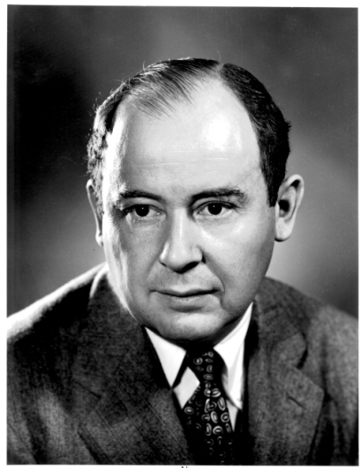

Merge Sort Algorithm
Don Knuth cites John von Neumann as the creator of this algorithm
If a list has 1 element or 0 elements it is sorted
If a list has more than 2 split into into 2 separate lists
Perform this algorithm on each of those smaller lists
Take the 2 sorted lists and merge them together

Slide 110
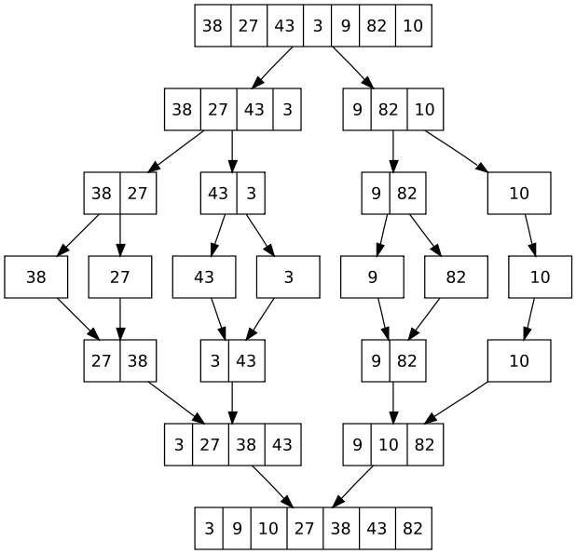
Merge Sort

Slide 111
Final Comments
Language libraries often have sorting algorithms in them
Java Arrays and Collections classes
C++ Standard Template Library
Python sort and sorted functions
Hybrid sorts
when size of unsorted list or portion of array is small use insertion sort, otherwise use O(Nlog N) sort like Quicksort of Mergesort
Many other sorting algorithms exist.

